Slide 1
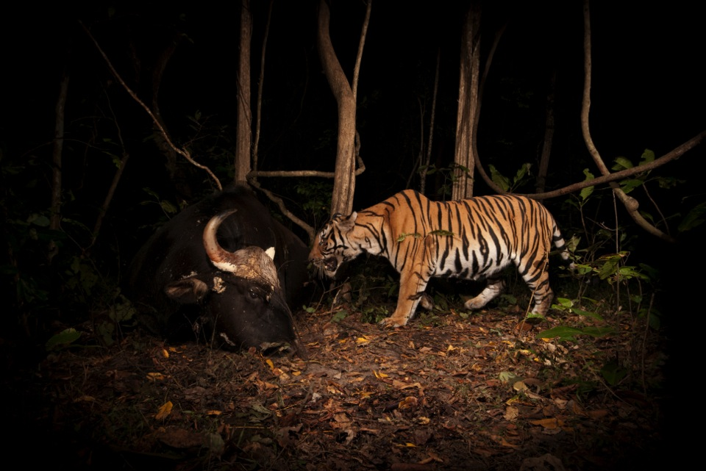
Wildlife crime and law enforcement in protected areas: introduction
ELIZABETH L. BENNETT ▪ WORLD PARKS CONGRESS 2014

Slide 2
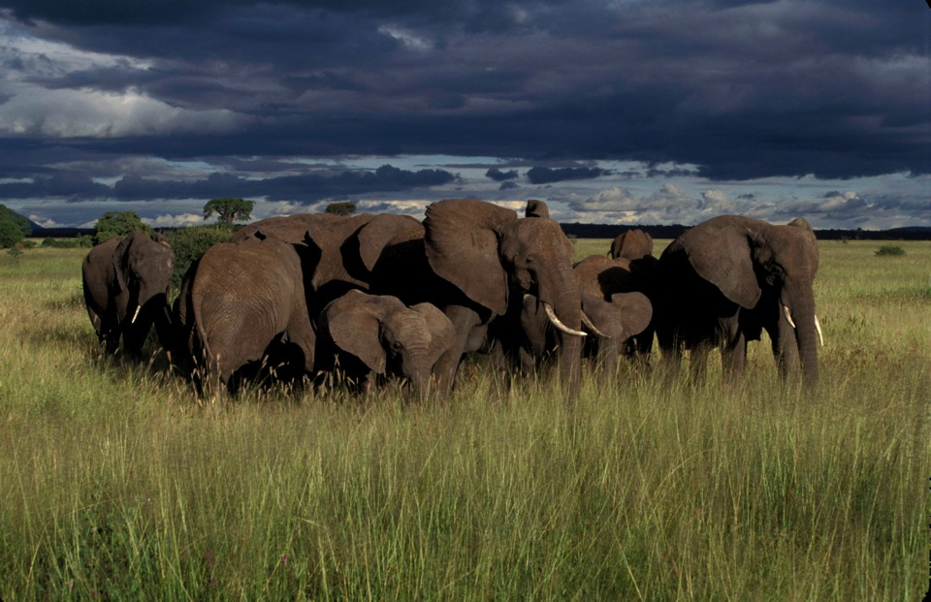
The issue
High-value species are being killed inside protected areas, not just outside them.
E.g., 2009-2013, Selous Wildlife Reserve, Tanzania, lost 66% of its elephants.

Slide 3
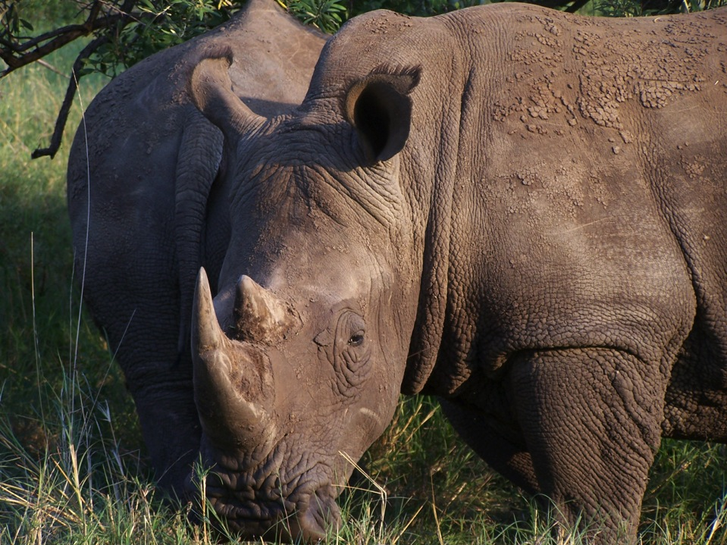
Last year, 1,004 rhinos were killed in Kruger National Park, South Africa.

Slide 4
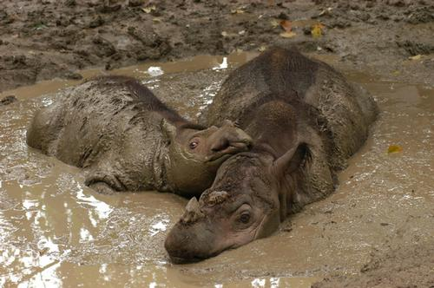
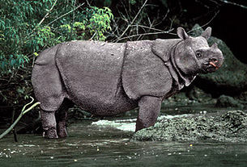
Sumatran and Javan rhinos are now extinct across mainland Southeast Asia, including from inside all protected areas.

Slide 5
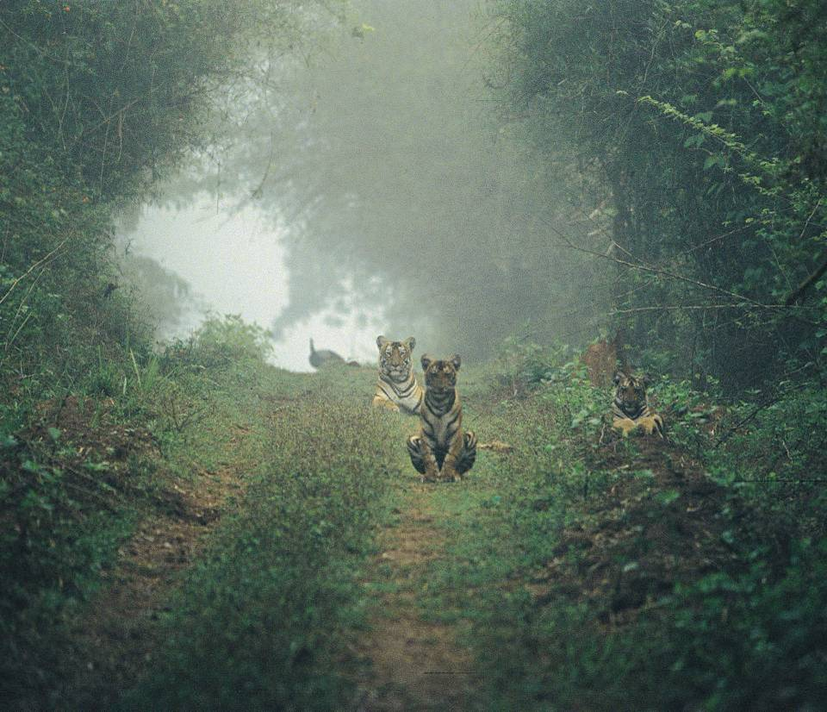
In India, tigers became extinct from Sariska and Panna Wildlife Reserves, although small populations are starting to re-establish following reintroductions.

Slide 6
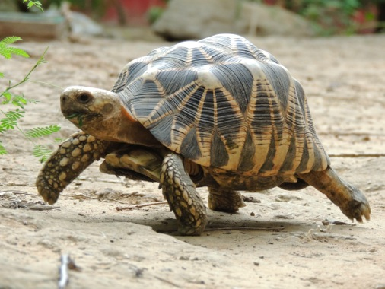
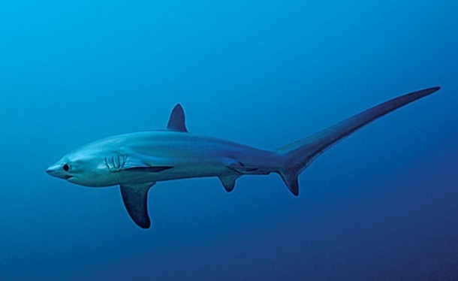
A similar picture exists for many smaller species, e.g., Burmese star tortoises were hunted to extinction in the wild, including in protected areas.
This overview focuses on terrestrial species, but the same is occurring for marine. E.g., illegal fishing of sharks inside the Galápagos Marine Reserve.
These losses are mainly due to illegal harvesting for international trade.

Slide 7
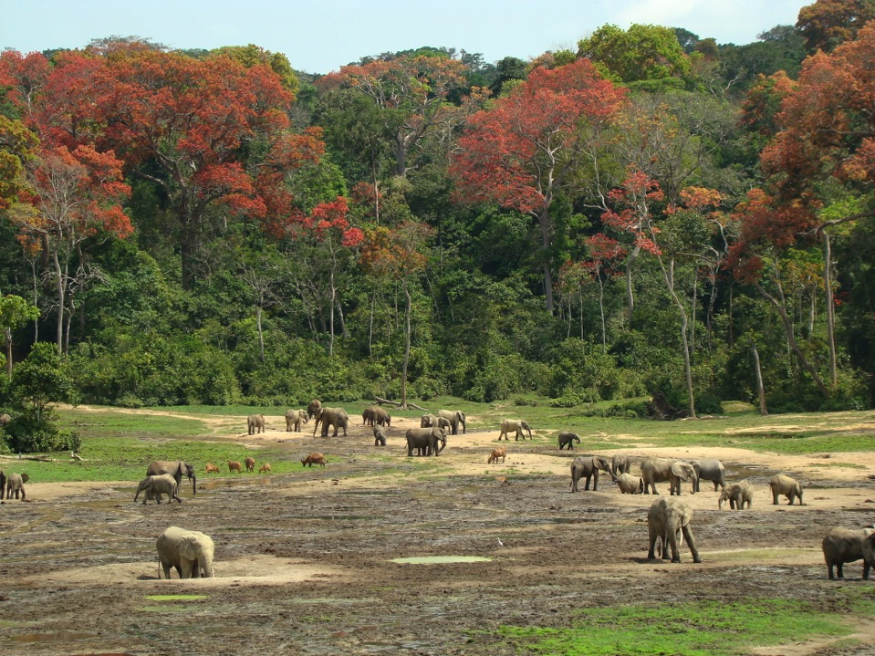
Implications
In addition to loss of charismatic species, such losses have wider implications. E.g., African forest elephants disperse seeds of > 96 species, and create and maintain mineral-rich clearings important to many species.

Slide 8
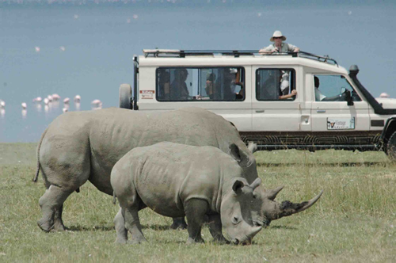
Such losses also damage livelihoods. In Kenya, wildlife tourism generates 12% of GDP, and supports ~300,000 jobs.

Slide 9
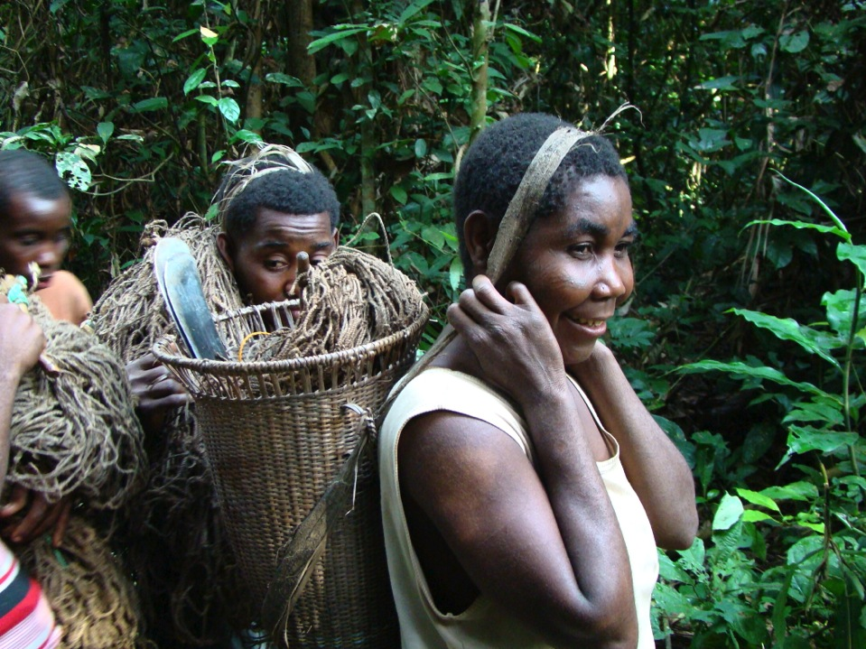
Security of local communities living in and around protected areas is also threatened by the armed poaching gangs.

Slide 10
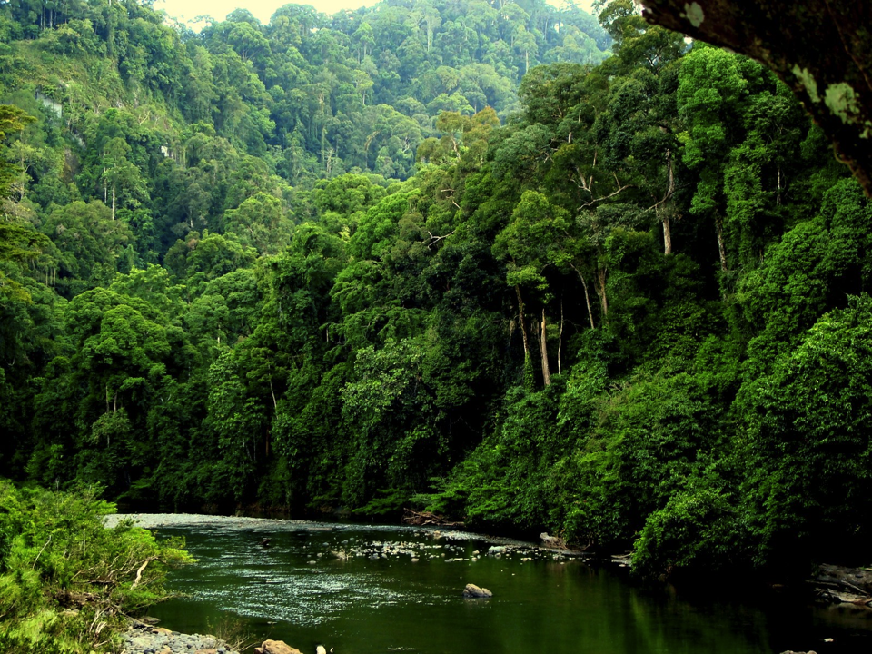
On the positive side, protected areas are the last, vital refuges for species affected by wildlife trafficking.
Proportion of range and total population in Protected Areas
Species | Range Area (km²) | Range in PAs (km²) | % range in PAs | % total popn in PAs
Tiger | 1,111,101 | 219,649 | 20% | 73-83%
Asian elephant | 926,776 | 186,339 | 20% | 65-85%
Gaur | 778,526 | 147,250 | 19% | 65-85%
Banteng | 190,933 | 106,180 | 56% | 85-95%
Greater one-horned rhino | 5,384 | 5,200 | 97% | >98%
Sumatran rhinoceros | 25,205 | 24,650 | 98% | >98%
Javan rhinoceros | 996 | 996 | 100% | 100%

Slide 11
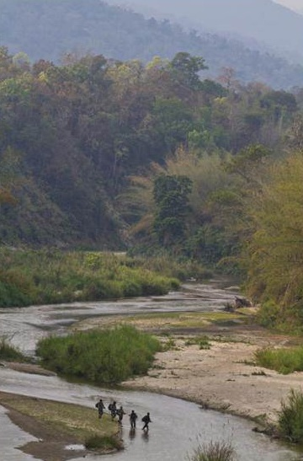
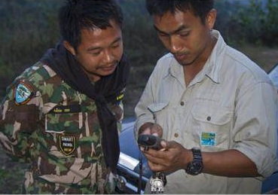
For PAs to play this role, long-term, hands-on management, including enforcement, is needed. This can be done by governments, local communities, NGOs, private sector, or some combination according to what’s locally appropriate.

Slide 12
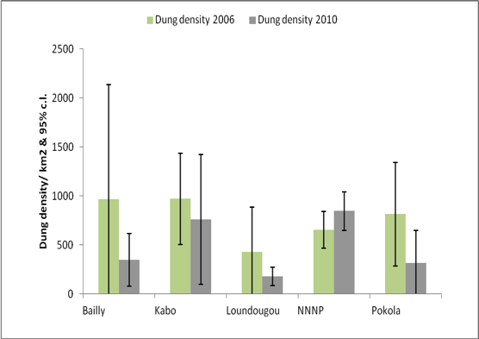
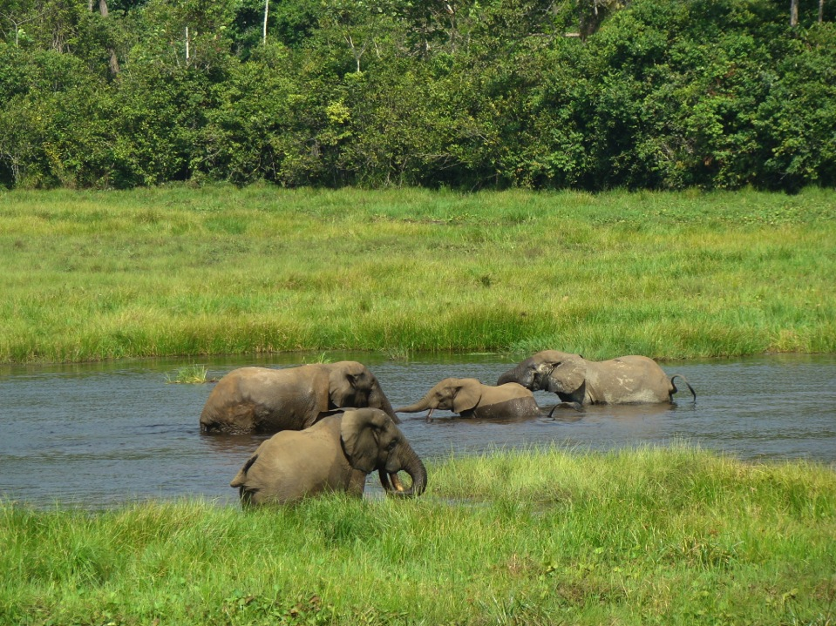
With such management, including SMART patrols, parks are very effective at conserving high value species, e.g., elephant densities in Nouabale-Ndoki NP, Congo, compared to surrounding logging concessions.

Slide 13
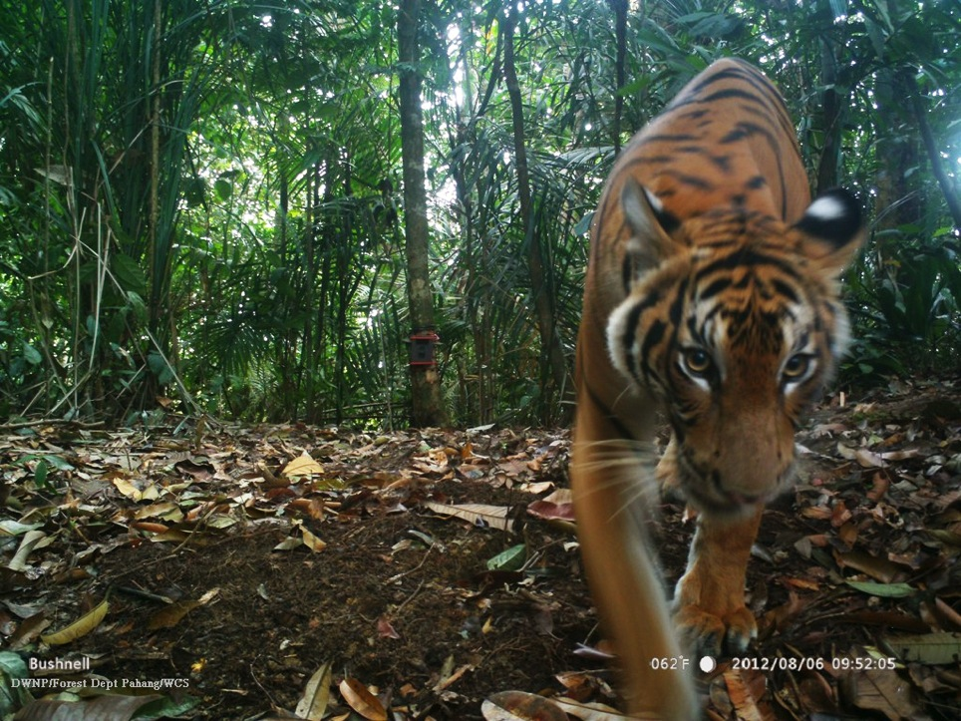
Given the high value of certain species, a challenge is securing sufficient funding for such protection.
E.g., effective tiger conservation costs
~$930/km²/year. Current spending is
~$500/km²/year.

Slide 14
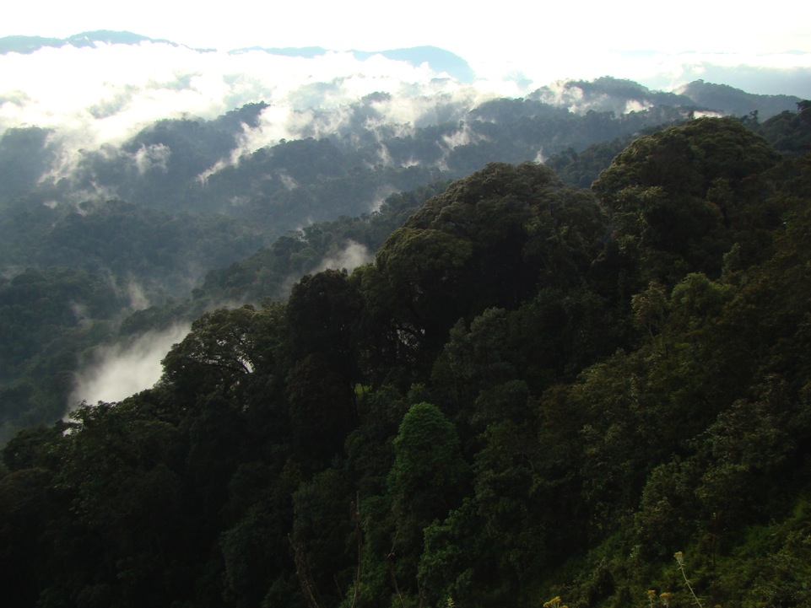
Support is needed at all levels, from local communities, civil society and governments, if high-value species are to be conserved, playing their full ecological role in protected areas, and re-expanding from those source areas across the wider landscape.
These two sessions give diverse examples of this, available tools and standards, and discussions on next steps needed.

Slide 15
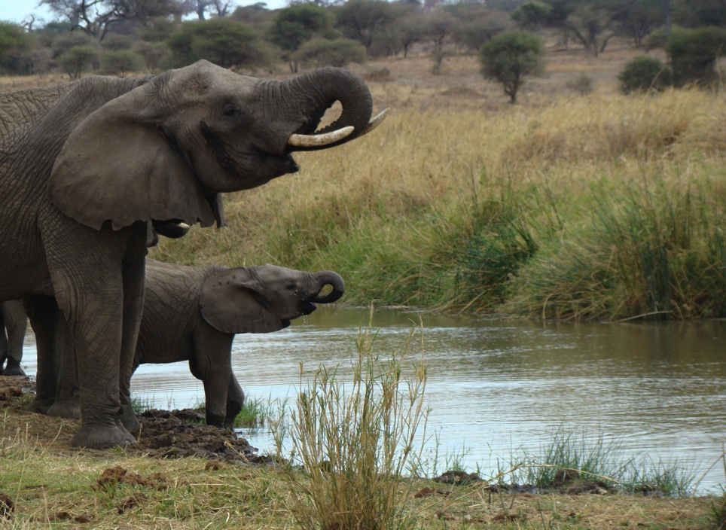
Learn more about WCS and the World Parks Congress. wpc.wcs.org ebennett@wcs.org
Thank You.

