Slide 1
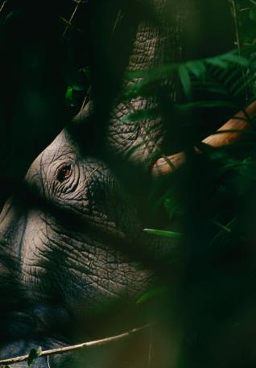
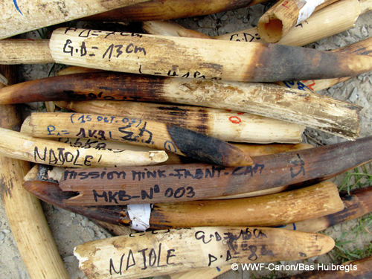
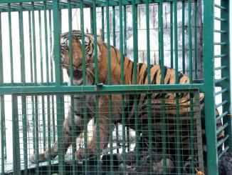
WCS’s work to combat the illegal wildlife trade
Susan Lieberman, PhD
Vice President, International Policy
Wildlife Conservation Society

Slide 2
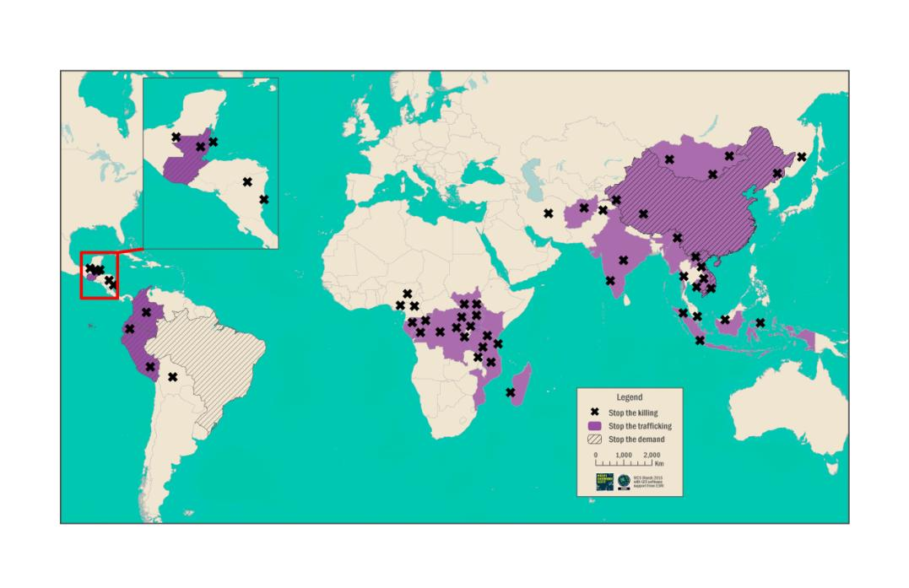
Global reach: WCS’s efforts to combat illegal wildlife trade:
Stop the killing, Stop the trafficking, Stop the demand
Notes:
WCS is working to combat IWT across the globe with very long established efforts to combat the illegal killing of tigers, elephants, and many other species in key sites in Africa, Asia, and the Americas and a more recent but large and rapidly growing wildlife trafficking, demand reduction, and policy programs.

Slide 3
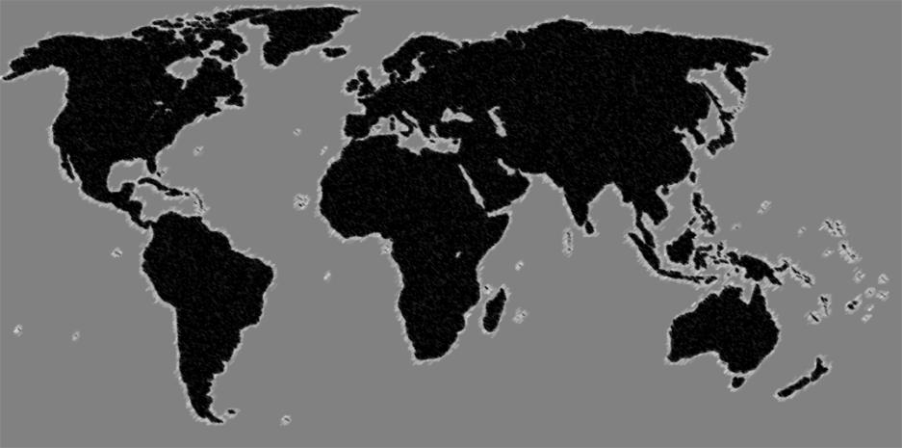
Global reach: WCS’s efforts to combat illegal wildlife trade:
A state-of-the-art confidential intelligence database of thousands of traffickers of nearly all protected species from all around the world.
Working enforcement relationships in all major source, transit, and destination countries.
Professionalized capabilities to execute and/or catalyze intelligence-led operations against traffickers at strategic, operational, and tactical levels.
INTERNATIONAL
POLICY
LEAD (VP)
GLOBAL WT
INTELLIGENCE
COORDINATOR
ASIA
ANTI-WT
COORDINATOR
IT
COORDINATOR
AFRICA
ANTI-WT
COORDINATOR
IT TAKES NETWORKS TO DEFEAT NETWORKS
Notes:
And recognizing that it takes networks to defeat IWT networks WCS has capitalized on it global network of field sites, country program offices, regional offices plus its long-established extensive network of relationships within countries to produce, analyze, and disseminate actionable intelligence to the appropriate agencies.
TALKING POINTS
Wildlife trafficking is a global problem, but the reality is that each country, each landscape requires a different set of practical solutions.
This means that an intelligence-led approach is the ONLY approach that will be successful against wildlife trafficking
This means evidence-based policy, intel-led enforcement, research-driven field programs
In order to do this, WCS has made a strategic investments in its anti-wildlife trafficking intelligence/analysis and action capabilities.
Centralized, standardized global intel database on wildlife traffickers, using state-of-the-art technology
Ongoing internal training and capacity building in major source, transit, and destination countries (starting with East Africa, SE Asia, and China), focusing on professionalization, best practices, and how to use information to catalyze action
Professional-quality intelligence analysis of wildlife trafficking networks and trends, conducted on a field/landscape level, country level, and regional levels, both internal and with partners. This enables us to move beyond generic analyses to create high-impact products that actually enable action – No more simple maps with arrows!
Well-thought out and close integration of this information and analysis into WCS field programs, as well as government enforcement action, and non-governmental initiatives.
WCS has the unique ability to develop, plan, and execute or facilitate the execution of action against wildlife traffickers

Slide 4
Documenting the Crisis
Mobilizing Political and Financial Support
Stopping the Killing
Stopping the Trafficking
Stopping the Demand
Notes:
WCS is of course well-known for its research and monitoring work and we are using that work to document the IWT crisis and mobilize political and financial support.

Slide 5
Central Africa’s Forest Elephant population declined by 65% between 2002 and the end of 2013
Notes:
To give but one example, WCS scientists lead a major study that showed that Central Africa’s Forest Elephant population declined by 65% between 2002 and the end of 2013. Such data, analyses, and reports are vital bot as a call to action and a guide to what action to take, where to take it, and whether we are succeeding.

Slide 6
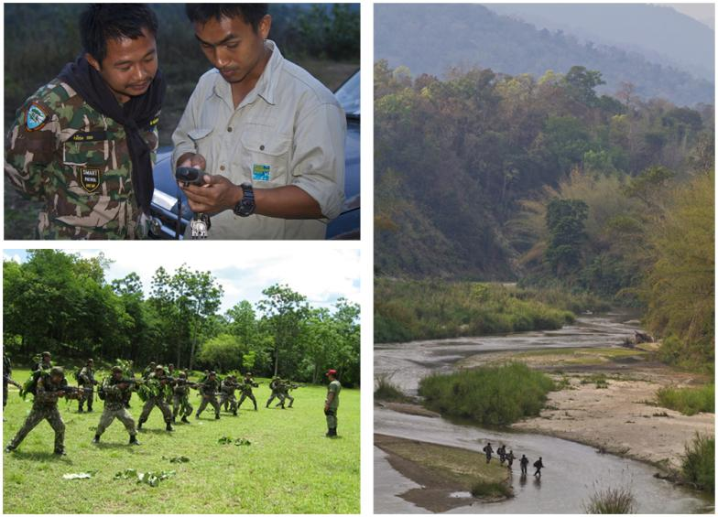
Stopping the illegal killing
Protecting tigers, rhinos, elephants, and many other species by supporting well-trained, well-equipped, well-managed ranger patrols in key sites
Notes:
Working to protect wildlife in key sites has long been a strength of WCS: protecting tigers, rhinos, elephants, and many other species by supporting well-trained, well-equipped, well-managed ranger patrols in key sites

Slide 7
…and we know protection works
There is a pressing need for more effective protection of wildlife at many more key sites. But of course such efforts to combat illegal killing are only part of what is needed…
Notes:
And whether we are talking about Tigers, elephants, rhinos, or many other species we know protection works. Unfortunately the necessary efforts are being made at too few sites. There is a pressing need for more effective protection of wildlife at many more key sites. But of course such efforts to combat illegal killing are only part of what is needed….

Slide 8
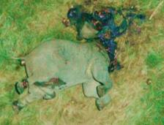
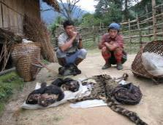
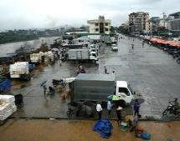
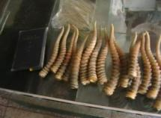
We have to address the problem along the wildlife trade chain, from illegal killing sites to points of final sale
Site
Landscape and Seascape
Transport nodes
End point
Poaching
Criminal networks
Global transport
Sales
WCS is actively combating trafficking. Our actions include:
Working with government law enforcement partners to promote intelligence-led law enforcement and successful prosecutions: breaking the criminal networks
Supporting development & implementation of CITES’ NIAPs
Improved stockpile management
Transport Task Force, United for Wildlife: Working with airline and shipping companies, IMO. WCO, CITES, and others
…and many other examples
Core Protected
Areas
Towns and villages in
and around sites
where middlemen
buy and sell wildlife
Where trade flows
converge -
international borders,
ports, airports
Urban areas where
products are sold
to consumers
Notes:
Slide is self explanatory. Perhaps end with a call for action focussing on more effective prosecutions and reporting of prosecution rate.

Slide 9
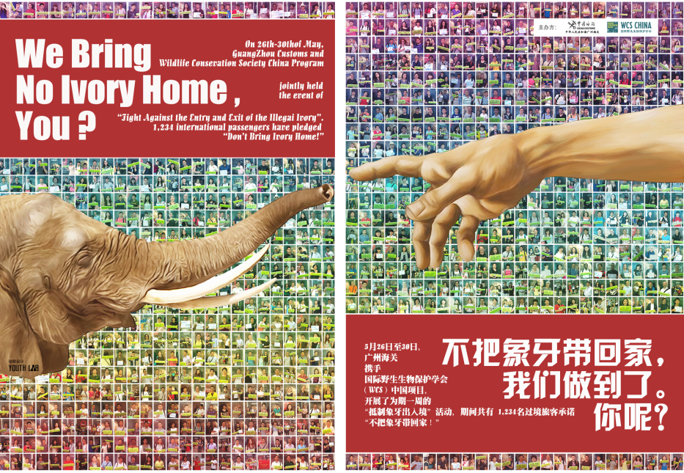
WCS’s Ivory Demand Reduction in China Beyond Awareness-raising: Changing Consumer Behavior
Providing information
Encouraging action Evidence-based (need for a better baseline)
Ivy
Notes:
And of course demand reduction is vital and, again to take just one example, WCS is actively working to effect consumer behavioral change in China so as to reduce the consumption of ivory. And if I may end with a final call to action, a lesson learnt from our work in China is that there is a pressing need for the conservation community to work together to produce a comprehensive baseline survey of demand for ivory in China.

Slide 10
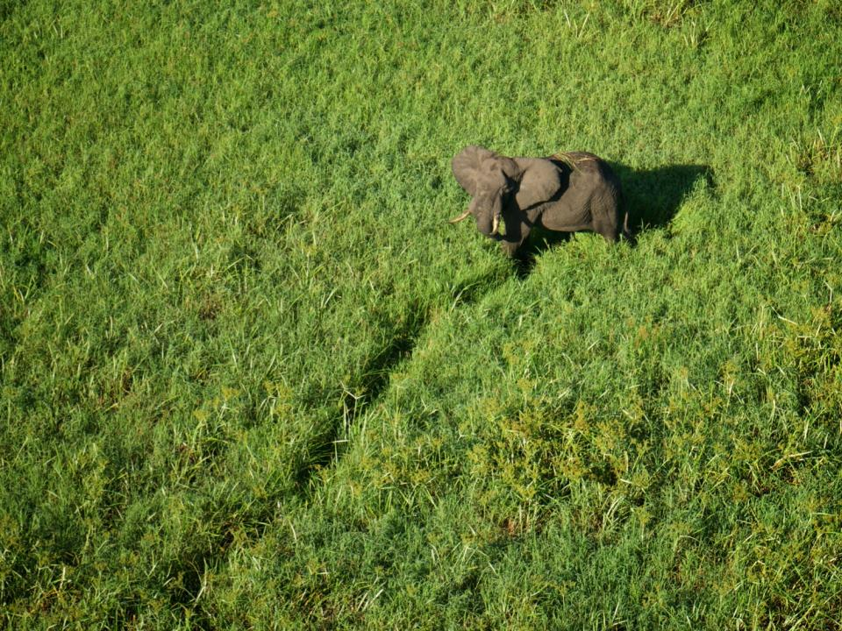
Thank you!

